Slide 1
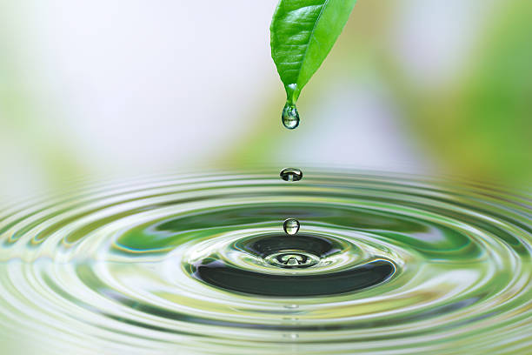
The Water Cycle

Slide 2

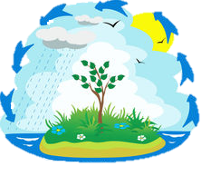
To understand the process of the water cycle
LEARNING INTENTION
SUCCESS CRITERIA
Describe how water continually cycles among land, ocean and atmosphere.
Identify the forms water takes through the water cycle
Describe how the sun and gravity impact the water cycle

Slide 3

The Water Cycle
To understand the process of the water cycle

Slide 4
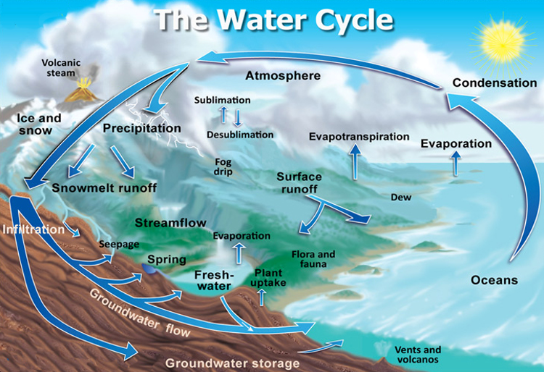
The Water Cycle
To understand the process of the water cycle
Is the process by which water circulates between the Earth’s oceans, atmosphere and land.
Is also known as the Hyrologic cycle.
It involves:
Water storage
Evaporation
Transpiration
Condensation
Precipitation
Runoff

Slide 5
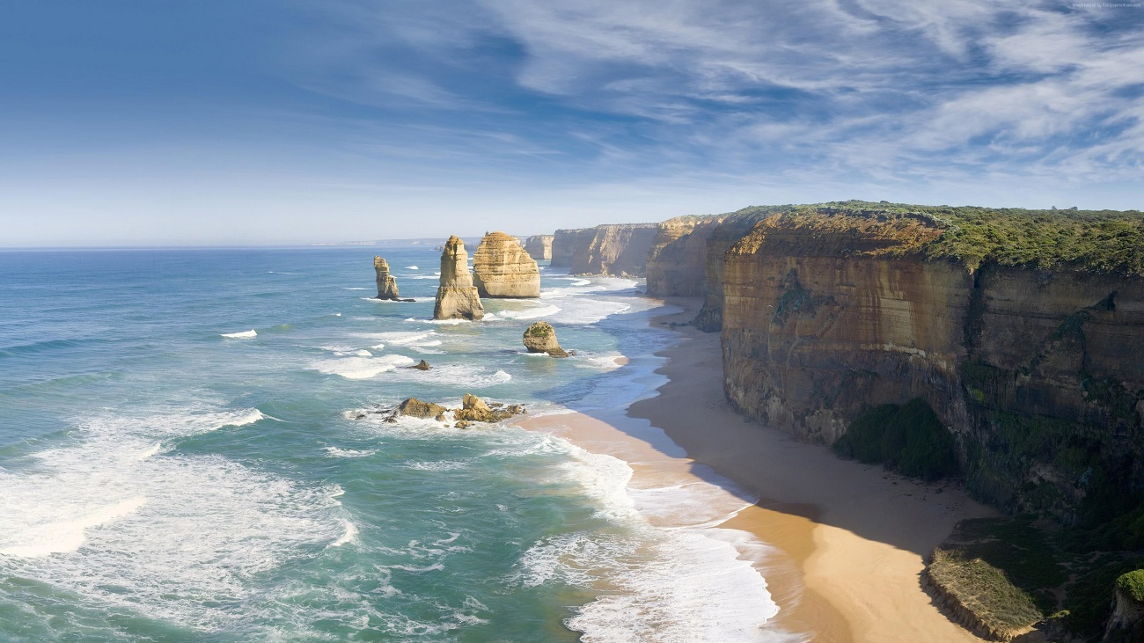
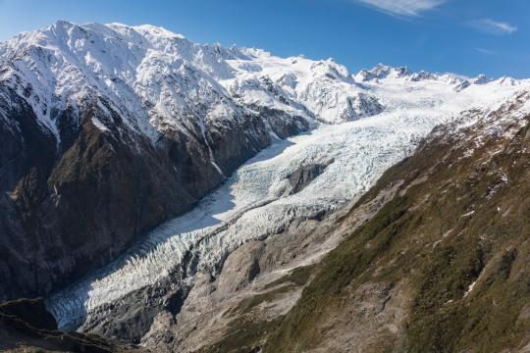
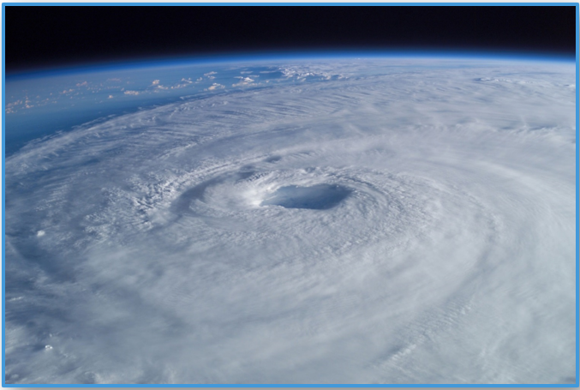
The Water Cycle – Water storage
To understand the process of the water cycle
Oceans store 96.5% of the Earth’s water.
Ice, snow or groundwater lock up water in its present state for a relatively long period of time.
Atmosphere is the superhighway used to transport water around the world.

Slide 6
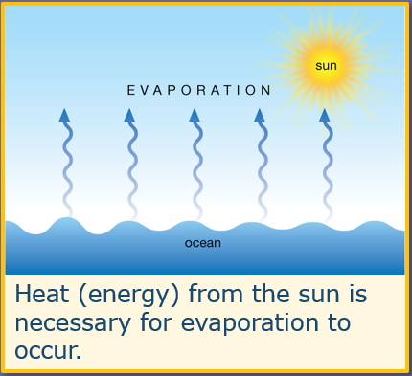
The Water Cycle - Evaporation
To understand the process of the water cycle
Is the process by which water changes from a liquid to a gas.
Primary pathway that water moves from the liquid state back into the water cycle as water vapour

Slide 7
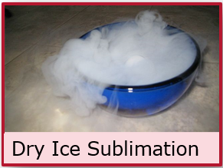
The Water Cycle - Sublimation
To understand the process of the water cycle
Is the process of snow and ice changing into water vapour without first melting into water.

Slide 8
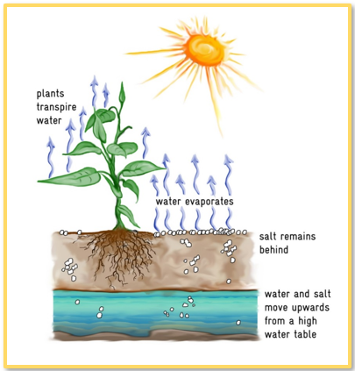
The Water Cycle - Transpiration
To understand the process of the water cycle
Water is absorbed by plants and trees, and then evaporates through their leaves.
Also known as evapotranspiration.

Slide 9
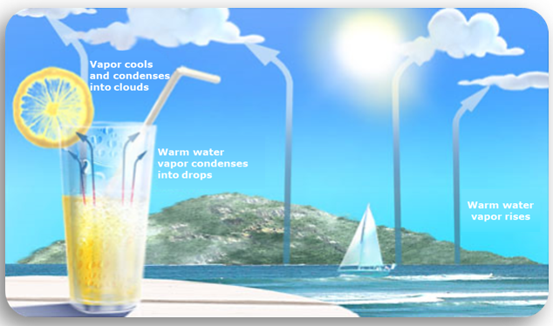
The Water Cycle - Condensation
To understand the process of the water cycle
The process by which water vapour in the air is changed into liquid water.
Forms clouds & fog.

Slide 10
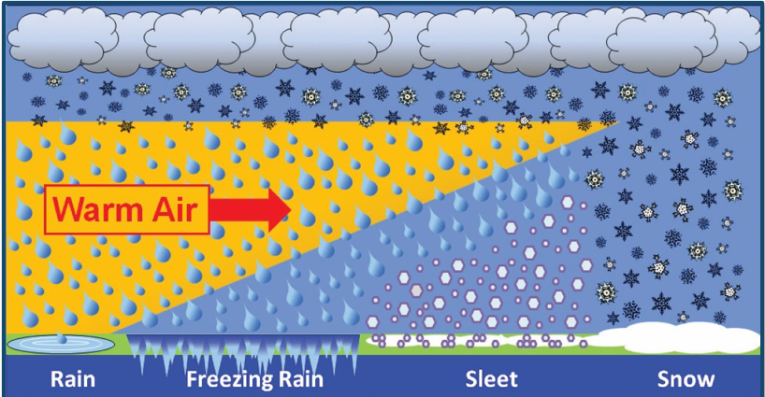
The Water Cycle - Precipitation
To understand the process of the water cycle
Water released from clouds in the form of rain, freezing rain, sleet, snow and hail.
Is the delivery system of atmospheric water to Earth.
Notes:
Rain: frozen precipitation melts and reaches the ground as rain. Freezing rain: Frozen precipitation melts in the warm air. Rain falls and freezes on cold surfaces.
Sleet: frozen precipitation melts in shallow warm air. Then refreezes into sleet before reaching the surface. Snow: falls through cold air and reaches the surface.

Slide 11
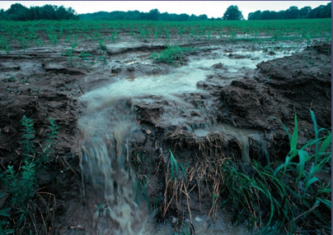
The Water Cycle - Runoff
To understand the process of the water cycle
Precipitation that didn’t get absorbed into the soil or evaporate.
Water moved by gravity makes its way into places that collect water (rivers, lakes, ponds & oceans)

Slide 12
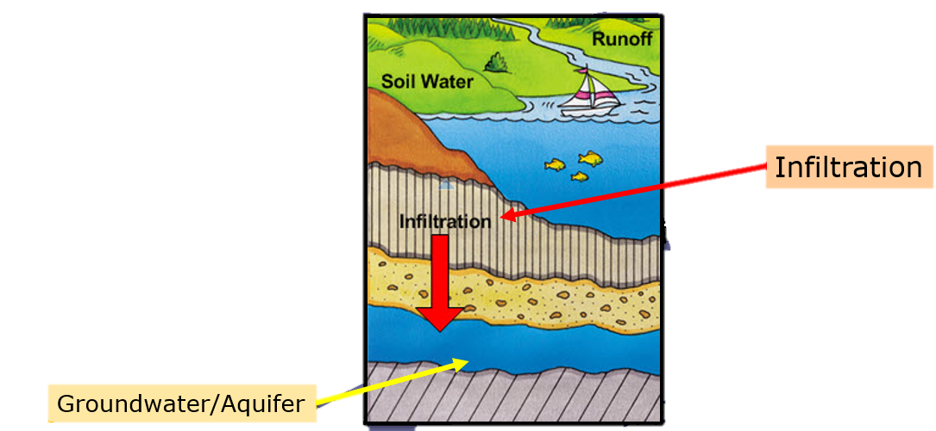
The Water Cycle
To understand the process of the water cycle
Groundwater are large amounts of water stored in the ground.
Infiltration is the downward process of moving water from the surface into soil or porous rock.
Aquifer is another name for groundwater. Usually a water-bearing formation

Slide 13
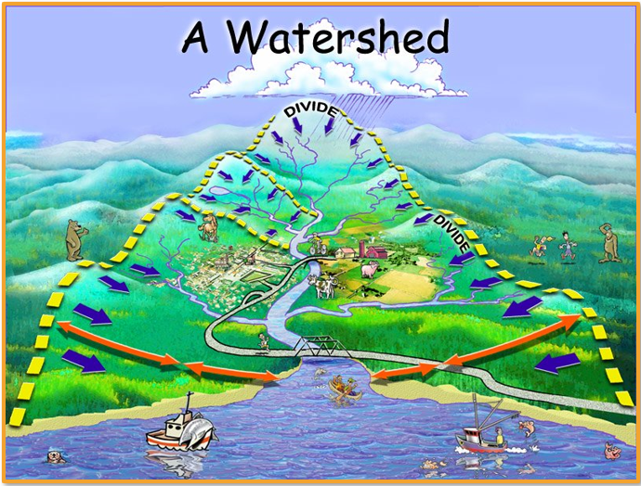
The Water Cycle - Watershed
To understand the process of the water cycle
Is an area of land where all the water that falls in it and drains off of, goes into the same place.
Can be as small as a footprint. Or as large as the land that drains into the Swan River.

Slide 14
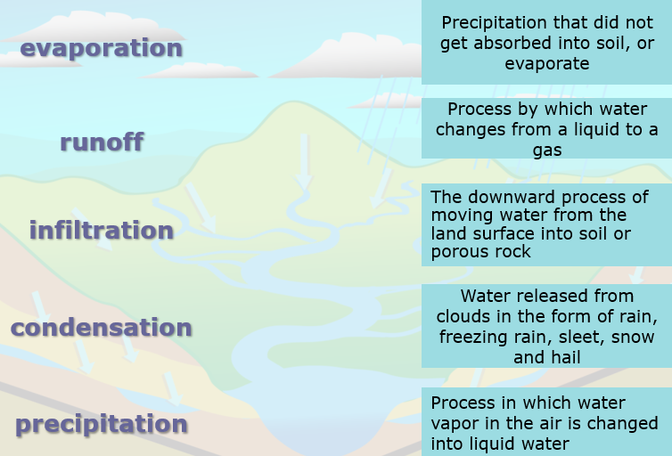
The Water Cycle
To understand the process of the water cycle
Match the stage of the water cycle to its correct description.

Slide 15
The Water Cycle
To understand the process of the water cycle
Check for Understanding: Answer the below questions in your book…
How does water continually cycle among land, oceans & the atmosphere?
What forms does water take through the cycle?
How is the water cycle impacted by the Sun and gravity?

